Slide 1
Consumer Finance Management System
Presented by
Abhishek Gupta
Nanda Kishore
Umang Kala
Ishita Agrawal
Divyani
Chandini

Slide 2
Table of Contents
01
02
03
Introduction
Problem
Statement
System Requirements and Tech Stack
04
05
06
Project Modules
Conclusión
Testing Coverage

Slide 3
Introduction
A Consumer Finance Management system is the software used to manage customer, product, product purchase and EMI transaction.
It allows the customer to buy products using no cost EMI card.
Enables customer to monitor their purchase history and installments.

Slide 4
Problem Statement
When user wants to purchase products using EMI feature of online shopping, user must have a credit card.
While payment of EMI every month, user has to pay some interest with EMI which varies for credit cards of different banks.
"Finance Management System" is a web application in which the concept of no cost EMI is introduced where user doesn't have to pay any interest on EMI and it is not mandatory for user to have credit card in order to purchase product via EMI since an EMI card will be given to users after Registration on this system if the user meets the eligibility criteria.
If all the documents provided by the user are approved, then EMI card gets activated for which user has to pay the joining fee for the card user chooses.
Using that EMI card, users will be able to purchase different products according to their card limit
The product which user will purchase; some processing fee will be taken from the user which will be an earning resource for the company.
The users will be able to view their purchased products in Dashboard and how much amount they are supposed to pay in upcoming months.

Slide 5
System Requirements
JDK 1.8 and above
Visual Studio code
IntelliJ
Node js
HeidiSql
Postman
Tech Stack
Spring boot
ReactJs
HTML
CSS
JPA
MySQL
System Requirements
and
Tech Stack

Slide 6
Project Modules
Registration
Admin Login
User Login
Dashboard
Product list
Product Details
Admin page
Forgot password
Update password

Slide 7
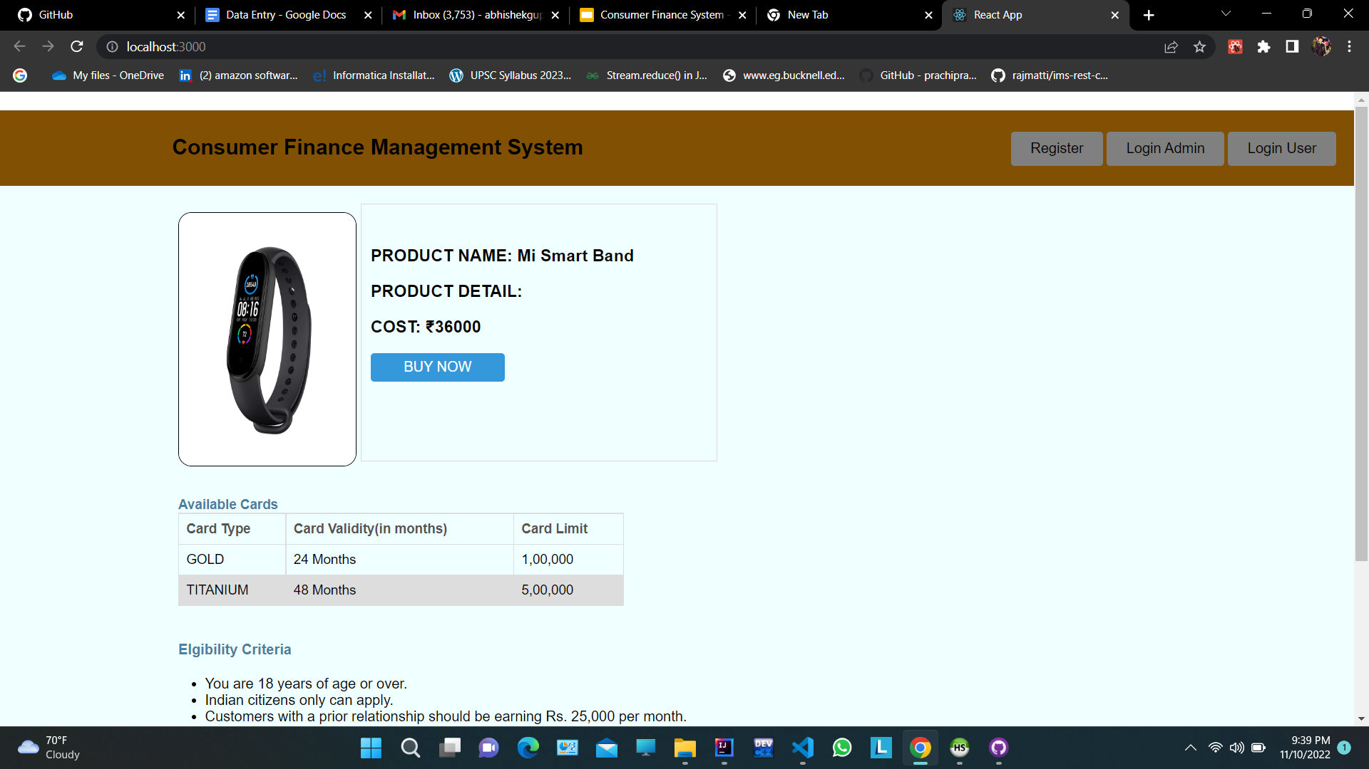
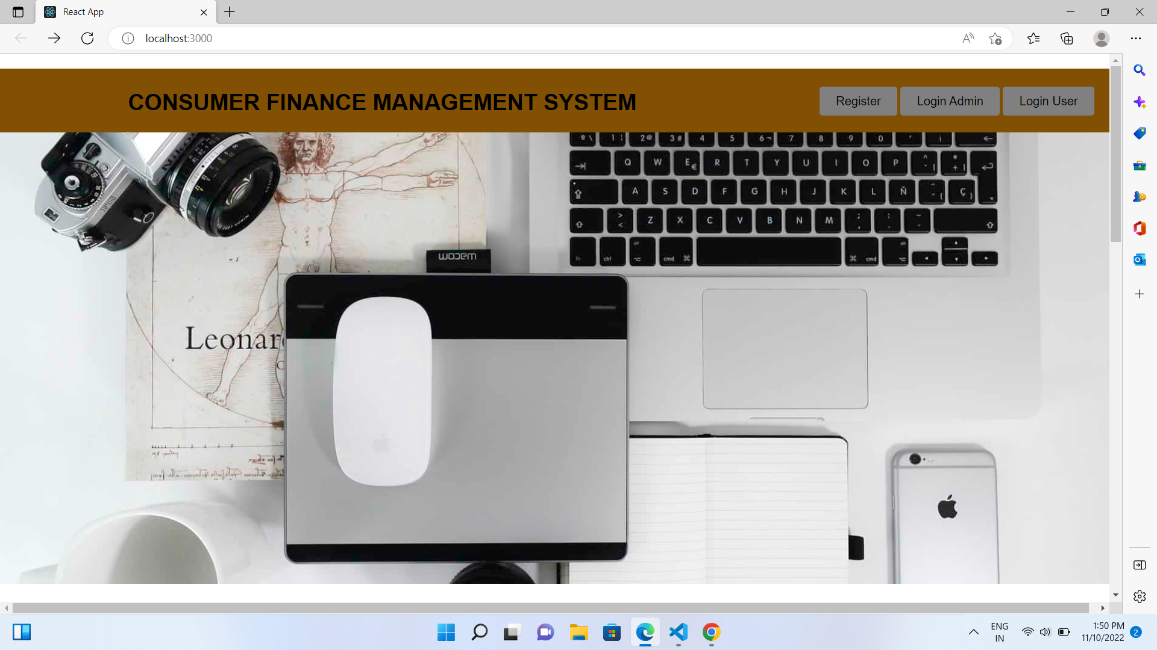
Index Page
New users can register, Admin and Existing Users can login.
Eligibility criteria for purchasing a new card is specified.
Terms and Conditions to buy the card are mentioned.
Card limits of Gold and Titanium card are given.

Slide 8
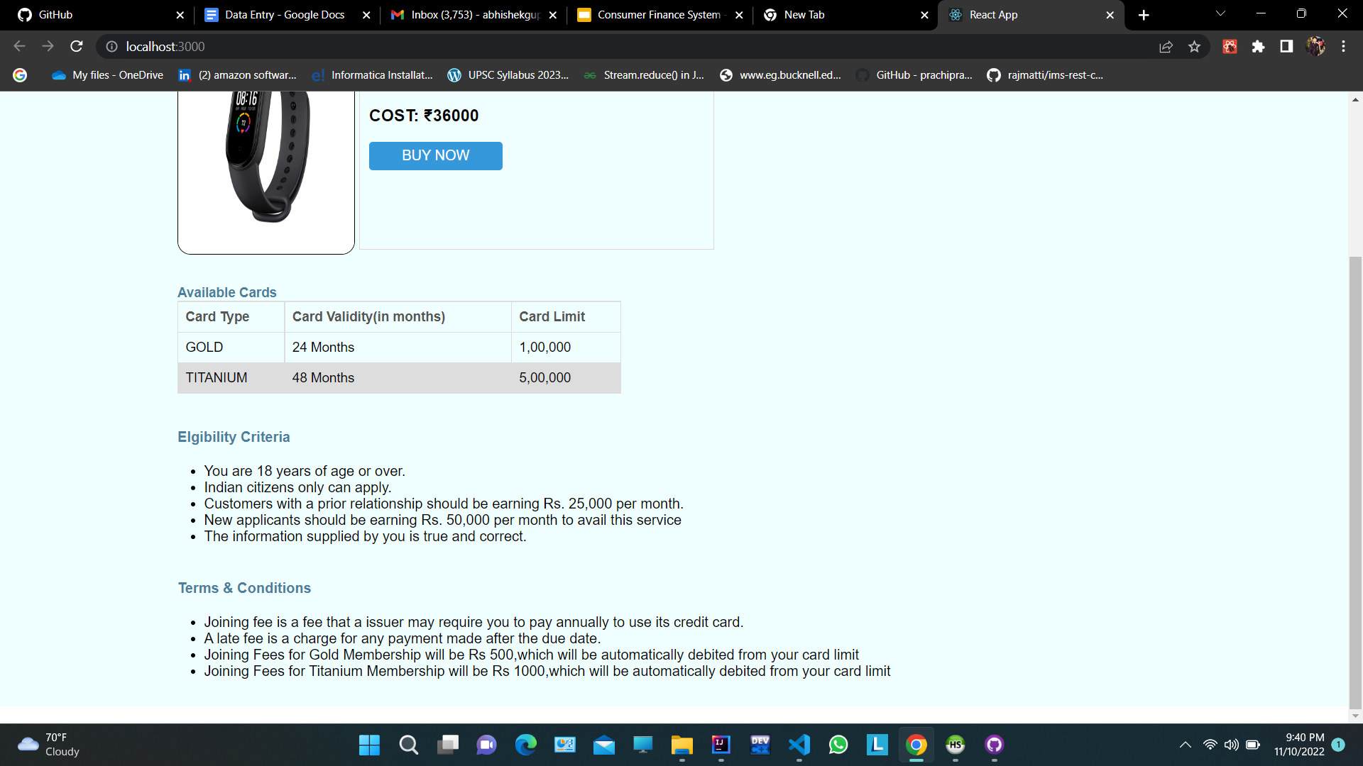

Slide 9
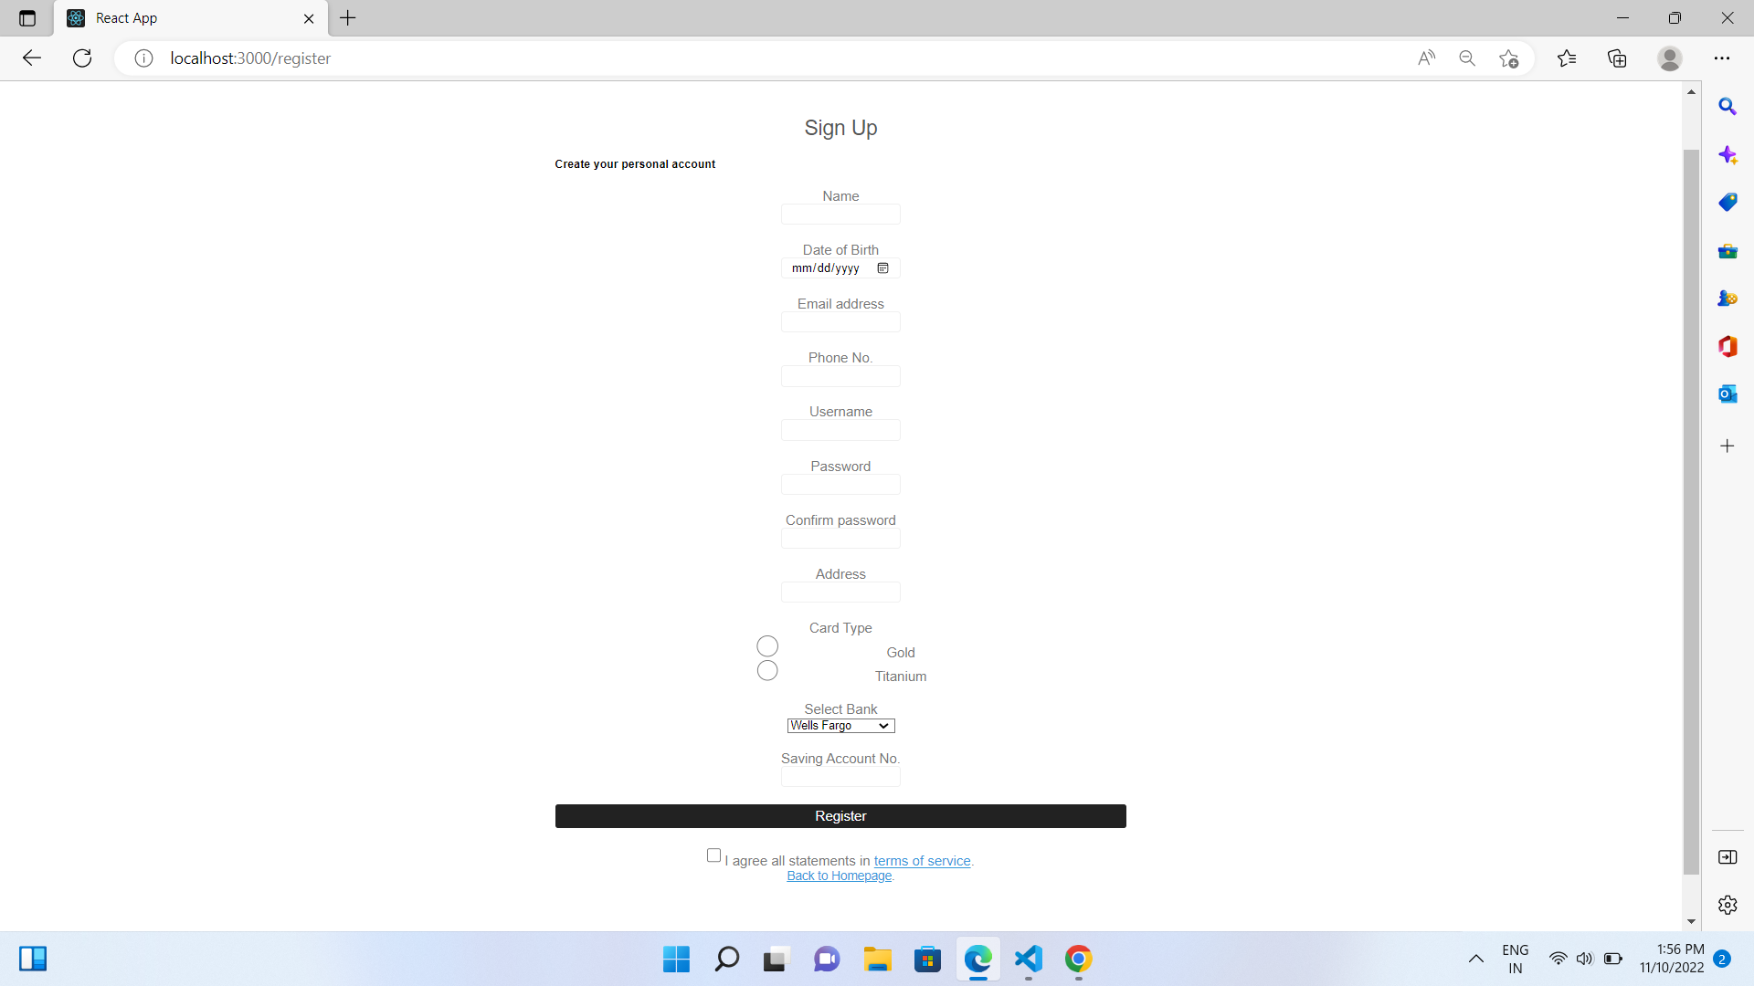
Registration Page
The consumer will register on the e-commerce website.
They can apply for any of the two cards depending on their requirements. The cards have a particular limit:
- Gold: Rs 1,00,000
- Titanium: Rs 5,00,000
Once the user is verified and registered with the company, they will be eligible to avail the services of the particular card.
The users will have to pay a minimum joining fee depending on the card type:
- Gold: Rs 500
- Titanium: Rs 2000

Slide 10
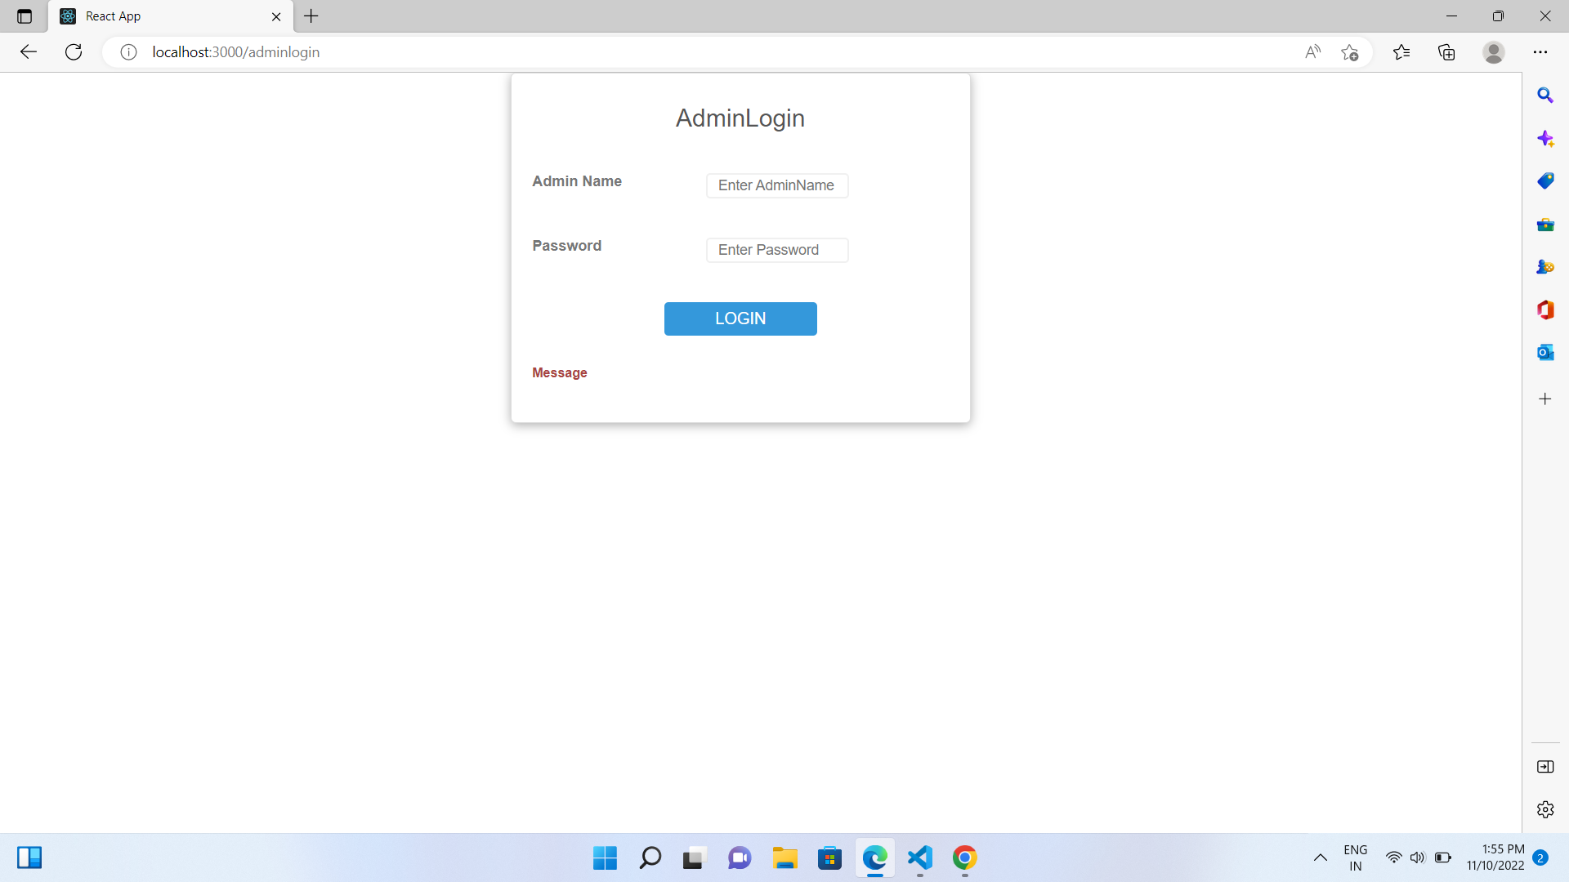
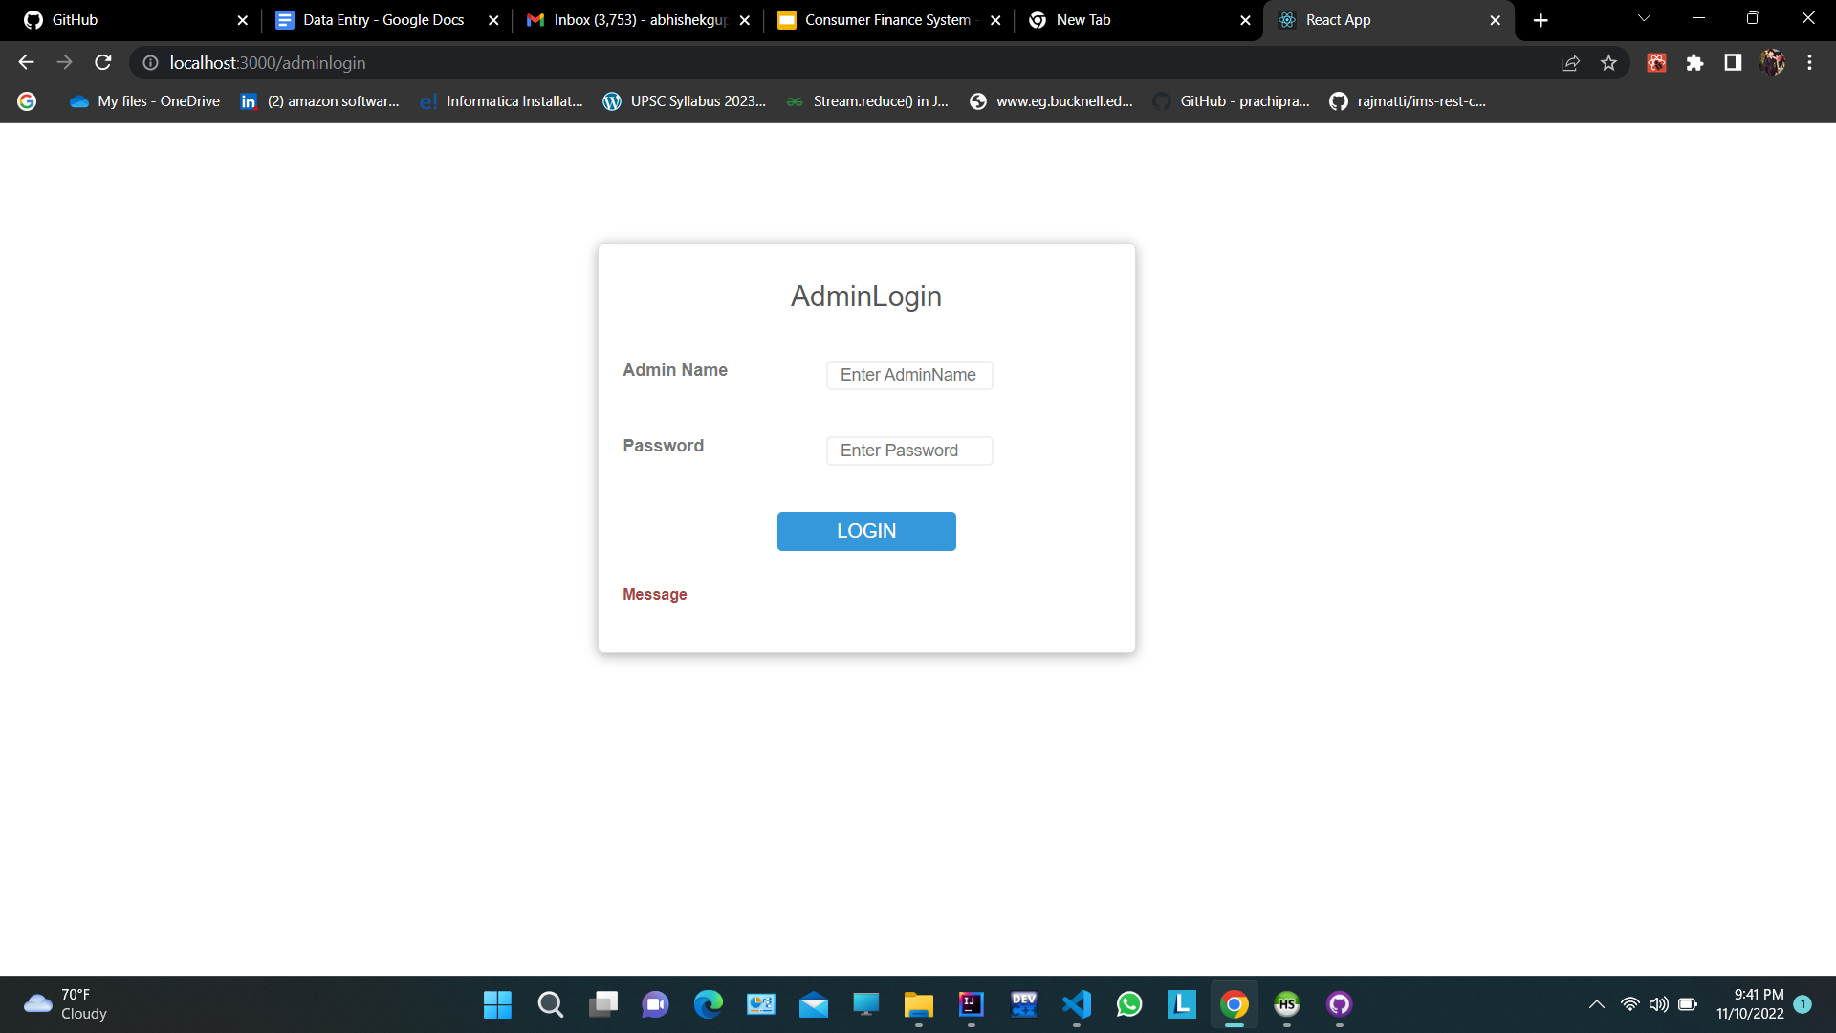
Admin
Login
Once the admin logs in their account, they will be able to access all the details of every user who has registered.
The admin will be able to activate the user account once the document verification is completed.
The admin will be able to create an EMI card for the customer (Gold or Titanium)

Slide 11
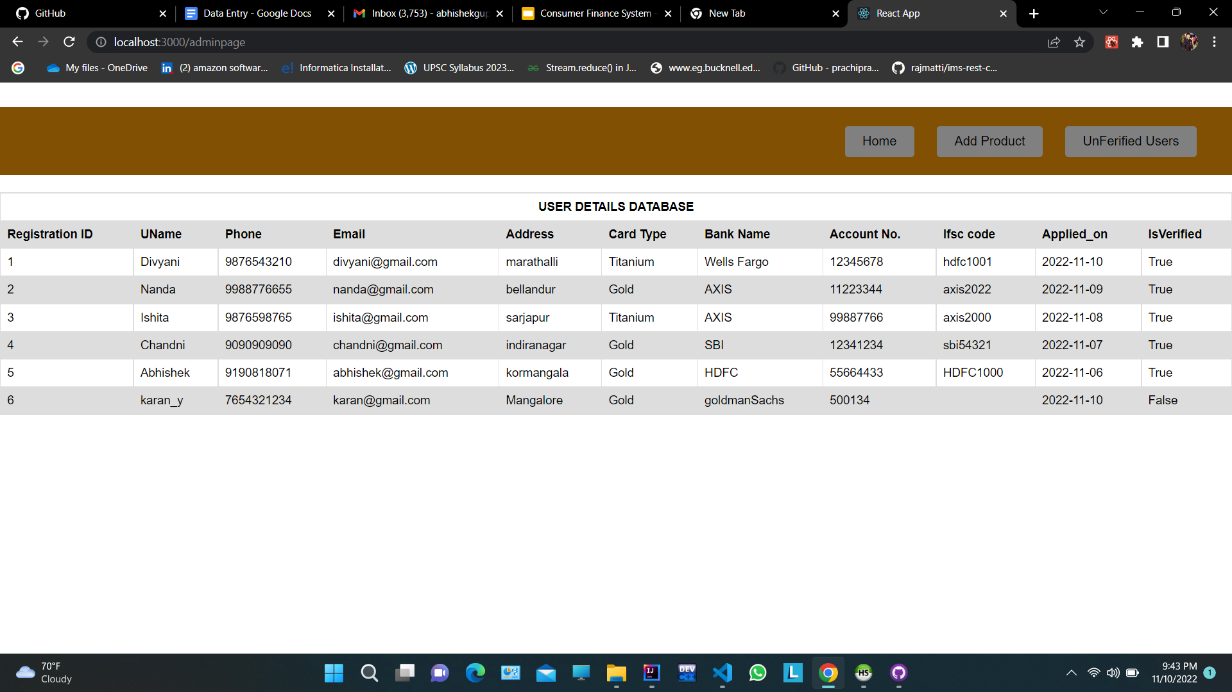
Admin
Page
The admin will be able to see all the user’s registered on the website.
The admin could see the verified status of the all the customers.

Slide 12
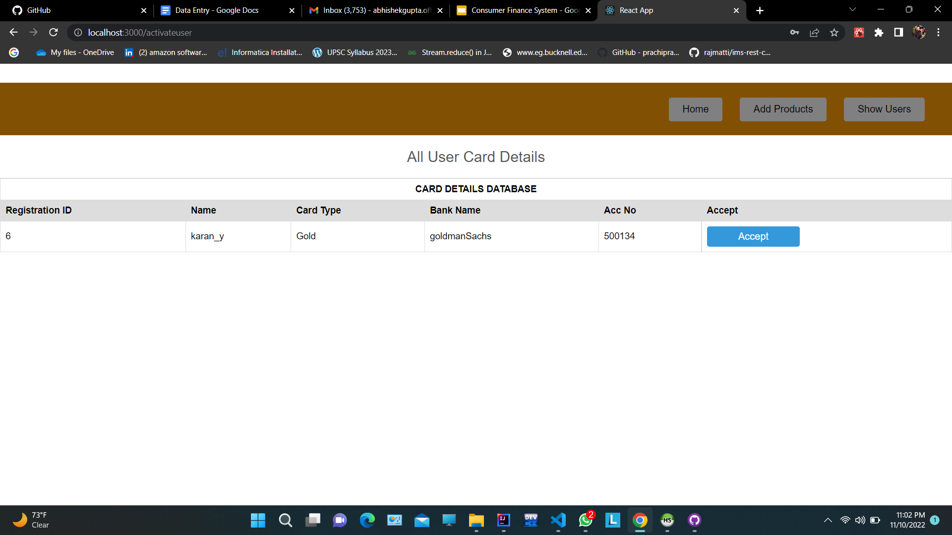
Activate User
`
The admin will be able to activate new cards for newly registered customers after manually validating the user bank details.

Slide 13
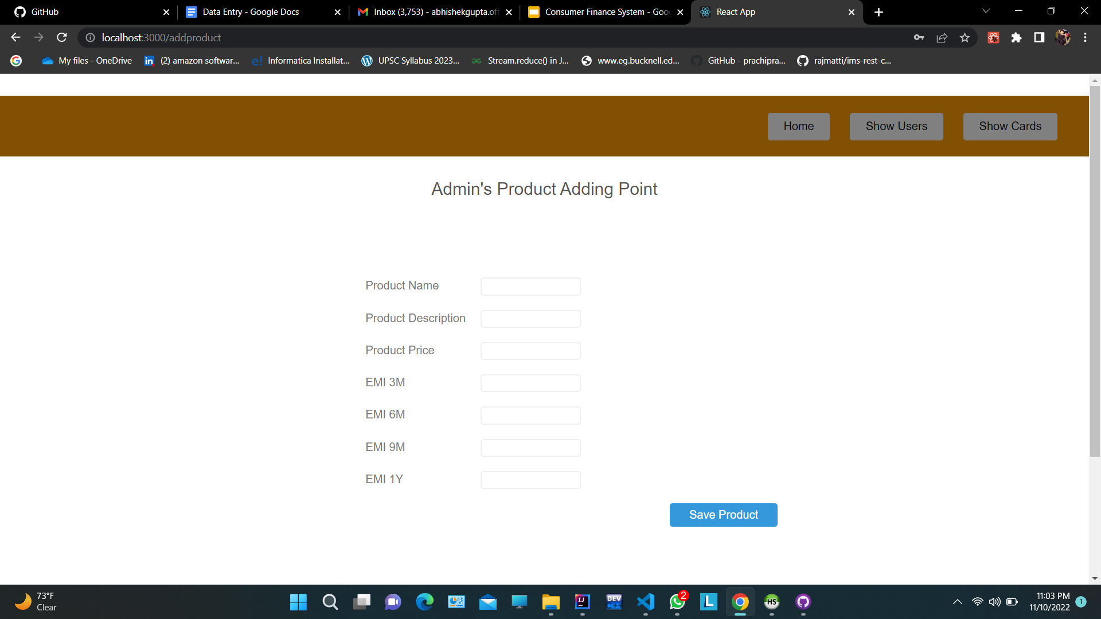
Add Product
Page
`
The admin will be able to add new products.
The admin will be able to access all the active cards of the customers.

Slide 14
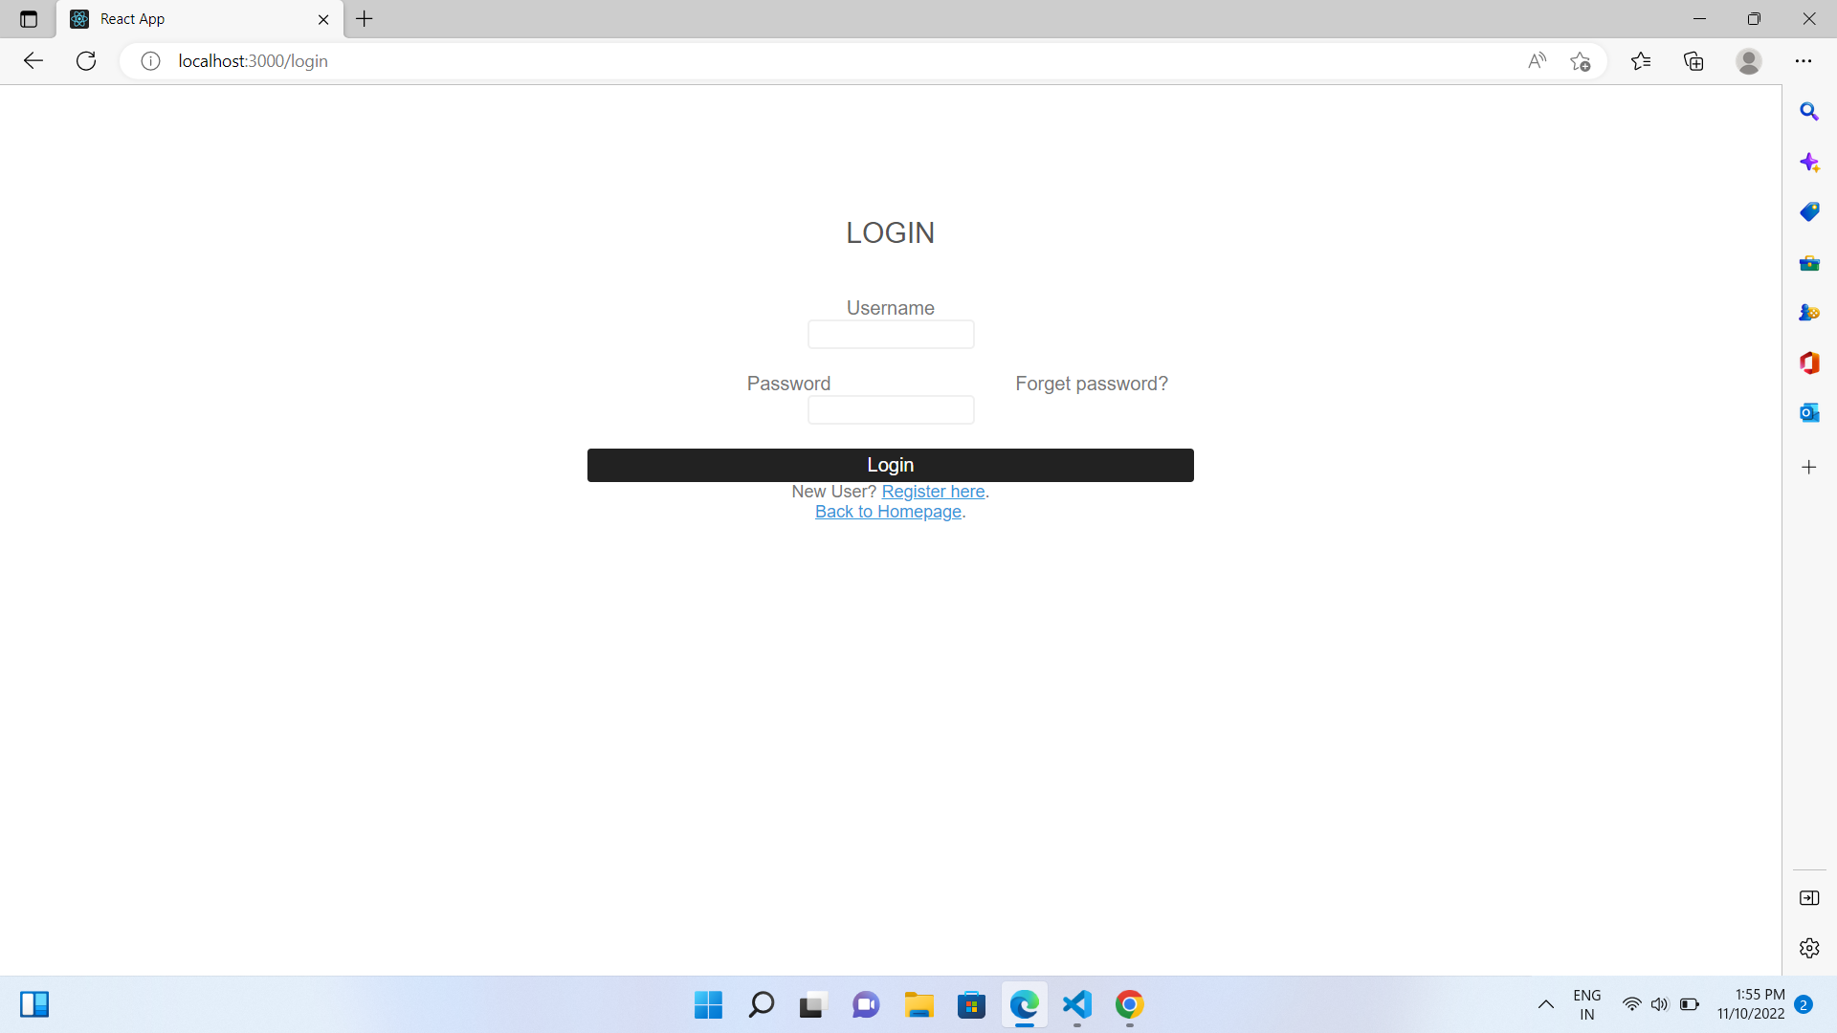
User Login
Once the user logins successfully into his account, he will be given the card to use henceforth.
User history ranging from the items chosen till the number of installments and the amount paid will be reflected.
It will also contain a reference to the list of the products page.

Slide 15
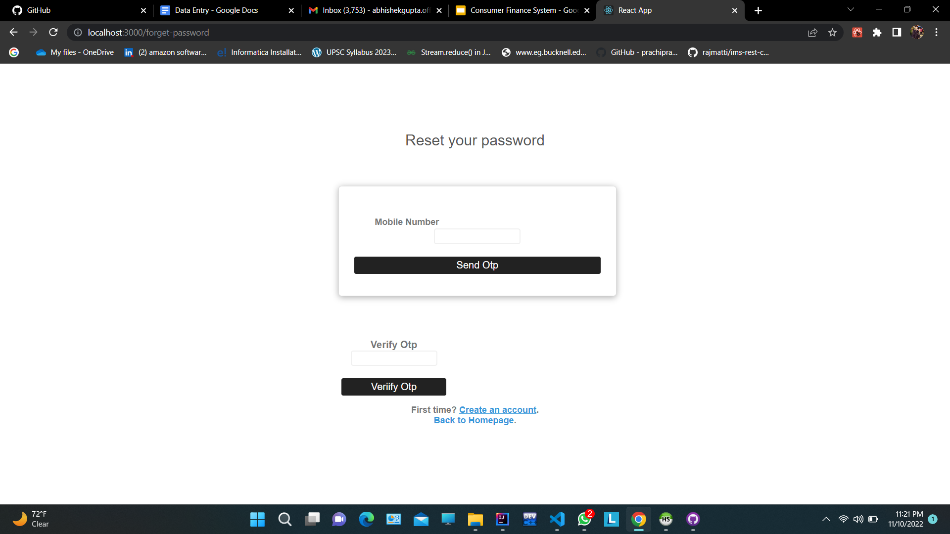
Forgot Password
If the user has forgot his password they can change their password by mobile OTP verification.

Slide 16
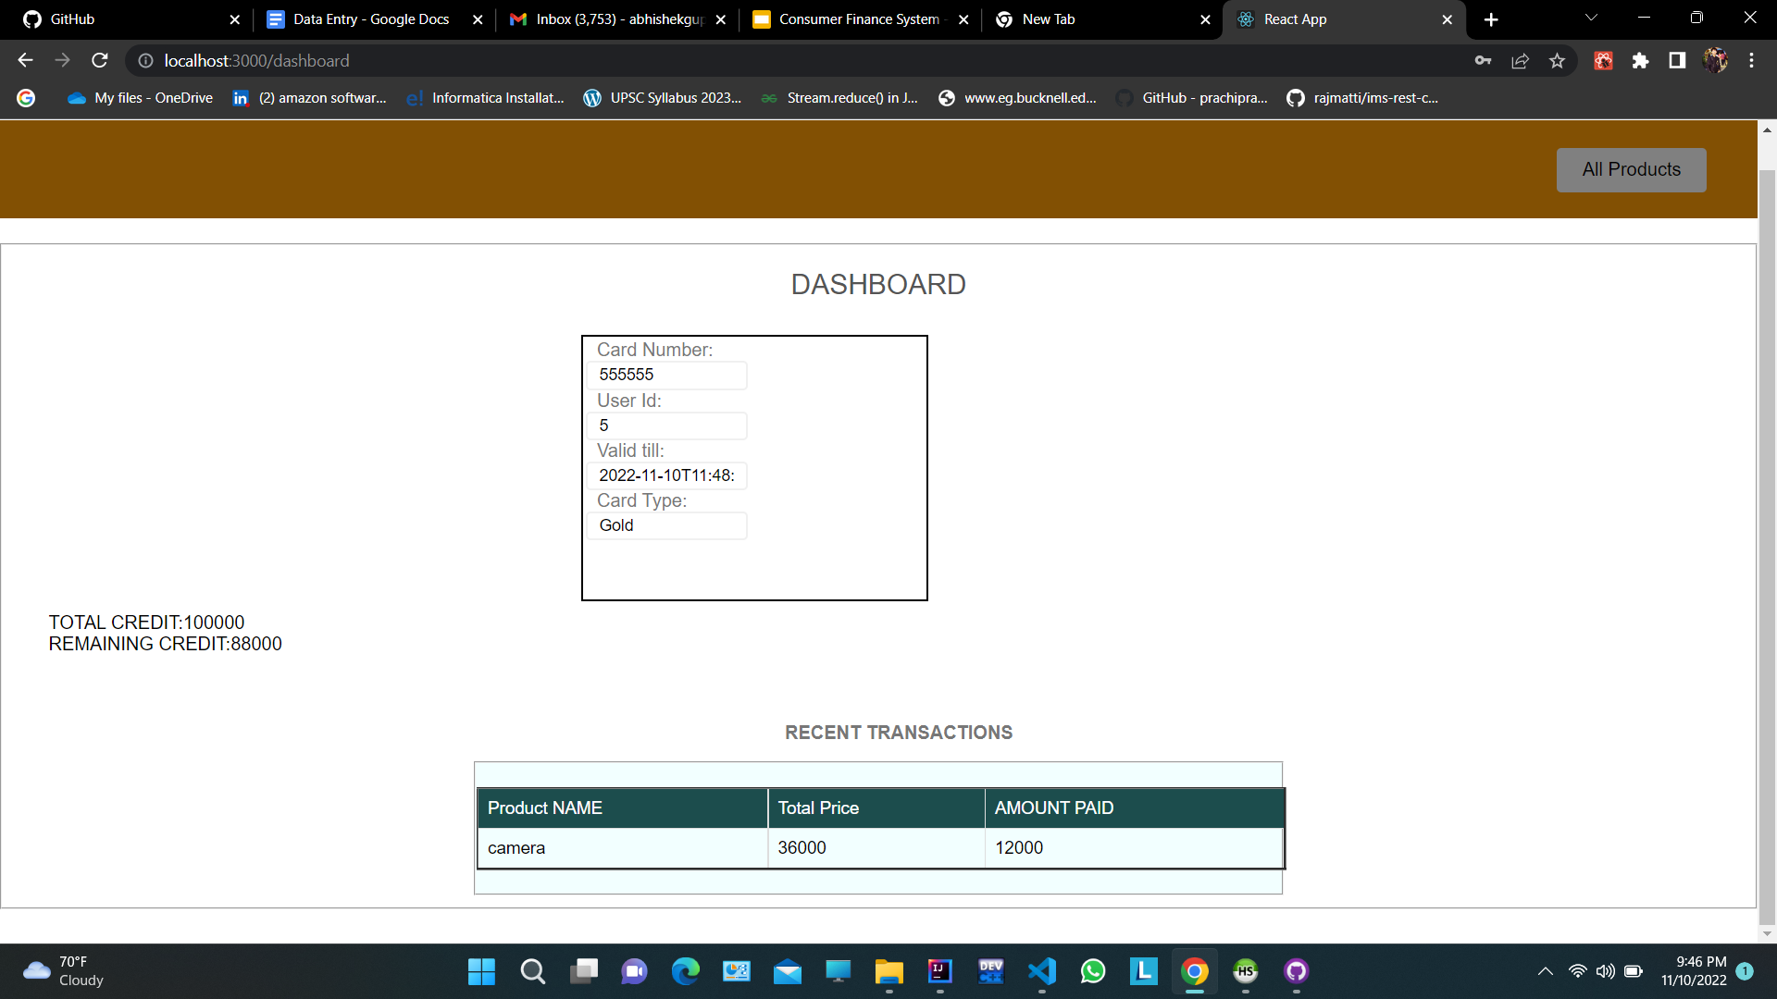
Dashboard
A virtual card is assigned to the user which the user can use only after the user pays the joining fee during document verification.
Once the verification is done, the admin will approve the use of the card. It will also have the information for the previous transactions.
Current card limit will also be shown on this page.
A navigation bar for products will be placed on the page.
When it is clicked, it will be redirect to the product list page.

Slide 17
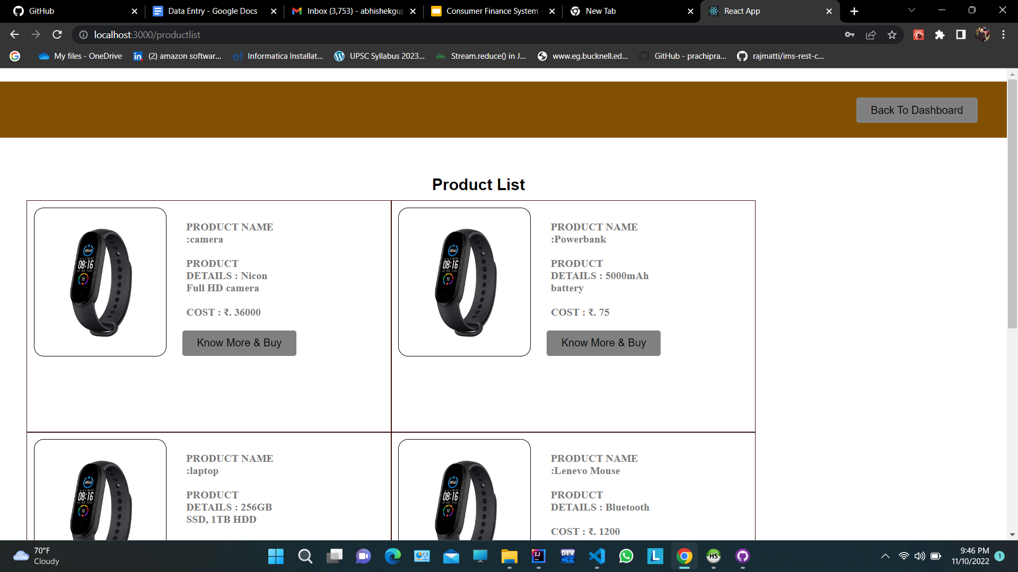
Product Page
All the products will be listed here. According to the product type, cost of the product and the tenure period, monthly tenures will be deduced.
Once the user clicks on buy product, he will be redirected to an product info page where all the details, price and features will be displayed for user's convenience.

Slide 18
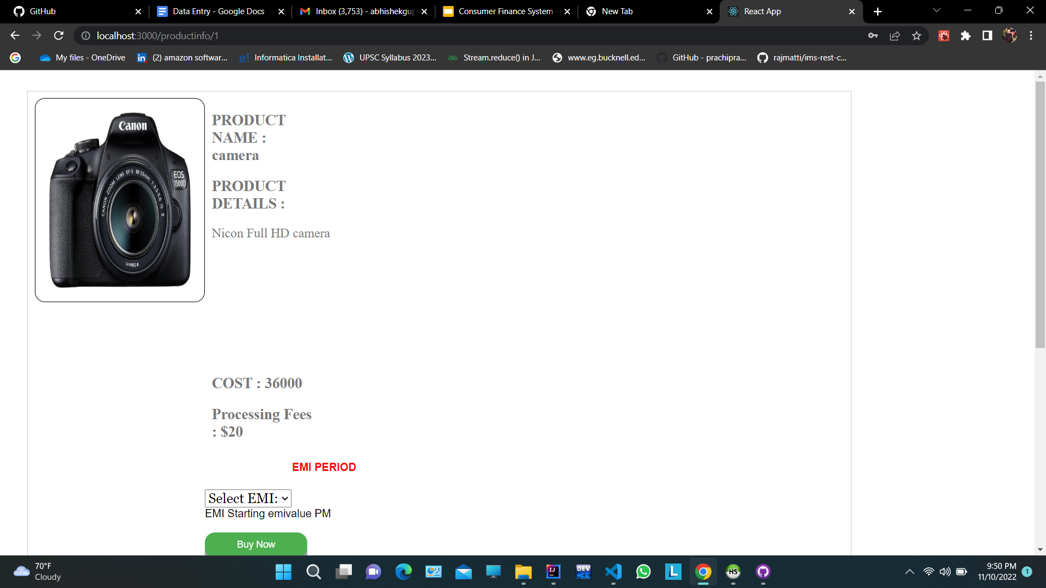
Product
Details
EMI for the product for various tenures will be calculated and displayed.
User can choose any of the tenure as per their convenience.
Once the user pays the monthly installment for the product, the pay now button will be deactivated for the rest of the month for that particular user.
Pay now will redirect to payment page.

Slide 19
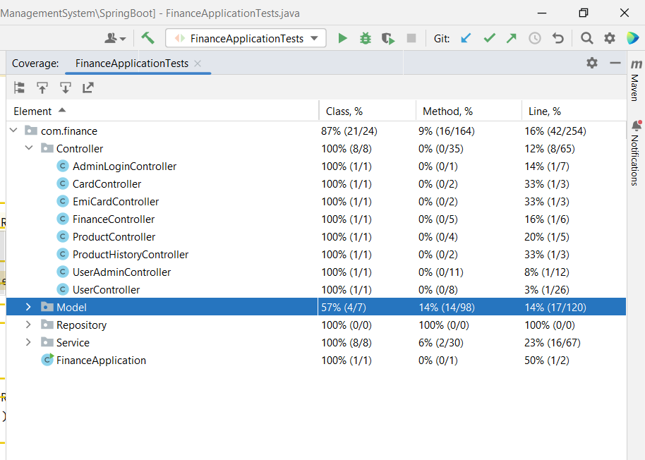
Testing Coverage

Slide 20
Conclusion
This Web Application facilitates buying product on no cost EMI.
It saves time and easy to operate.
It provides a digitalized way to manage consumer finances.

Slide 21
THANK YOU

